Slide 1
Mass Shootings

Slide 2
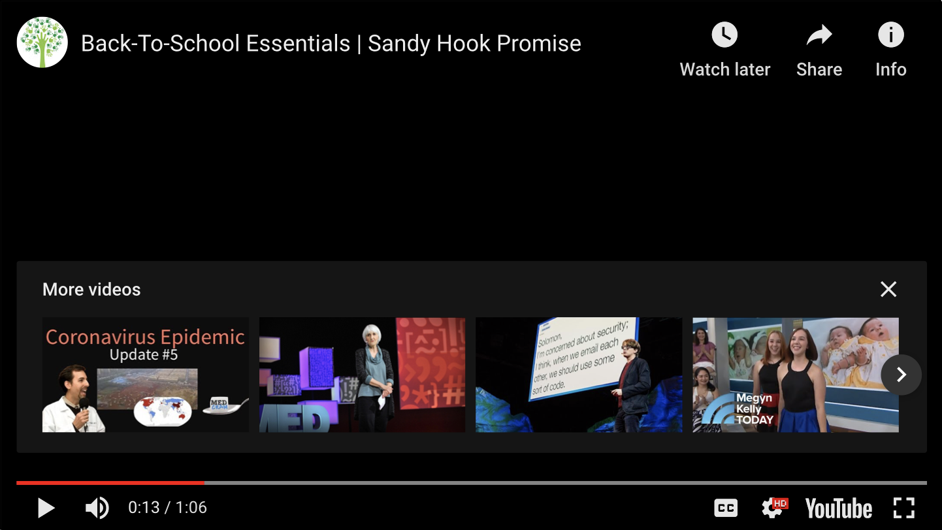

Slide 3
Sandy Hook Promise’s mission is to create a culture engaged in preventing shootings, violence, and other harmful acts in schools.
Sandy Hook Promise is a moderate, above-the-politics organization that supports sensible program and policy solutions that address the “human side” of gun violence by preventing individuals from ever getting to the point of picking up a firearm to hurt themselves or others.
Sandy Hook Promise is a national non-profit organization founded and led by several family members whose loved ones were killed at Sandy Hook Elementary School on December 14, 2012.
Involved in the organization is also a talented staff of seasoned professionals

Slide 4
EACH DAY 8 children die from gun violence in America.
Another 32 are shot and injured.
Firearms are the second leading cause of death among American children
and adolescents, after car crashes.
The U.S. has had 1,316 school shootings since 1970 and these numbers are increasing. 18% of school shootings have taken place since the tragedy at Sandy Hook Elementary School in December 2012.
2018 had the most school shootings on record, but U.S. Dept. of Homeland Security research shows that if we “know the signs” of gun violence,
we can prevent it and reverse the trend.
.

Slide 5
Guns used in about 68% of gun-related incidents at schools were taken from the home, a friend or a relative
39% of parents wrongly believe children don’t know where a gun is stored.
An estimated 4.6 million American children live in a home where at least one gun is kept loaded and unlocked
A study found that 77% of active shooters spent a week
or longer planning their attack
In almost every documented case of active shooters,
warning signs were given off

Slide 6
The Victims at Sandy Hook Elementary School
Allison Wyatt, 6
Ana Marquez-Greene, 6
Anne Marie Murphy, 52 (Teacher)
Avielle Richman, 6
Benjamin Wheeler, 6
Caroline Previdi, 6
Catherine Hubbard, 6
Charlotte Bacon, 6
Chase Kowalski, 7
Daniel Barden, 7
Dawn Lafferty Hochsprung, 47 (Principal)
Dylan Hockley, 6
Emilie Parker, 6
Grace McDonnell, 7
Jack Pinto, 6
James Mattioli, 6
Jesse Lewis, 6
Jessica Rekos, 6
Josephine Gay, 7
Lauren Rousseau, 30 (Teacher)
Madeleine Hsu, 6
Mary Sherlach, 56 (Psychologist)
Noah Pozner, 6
Olivia Engel, 6
Rachel D'Avino, 29, (Therapist)
Victoria Soto, 27 (Teacher)

Slide 7
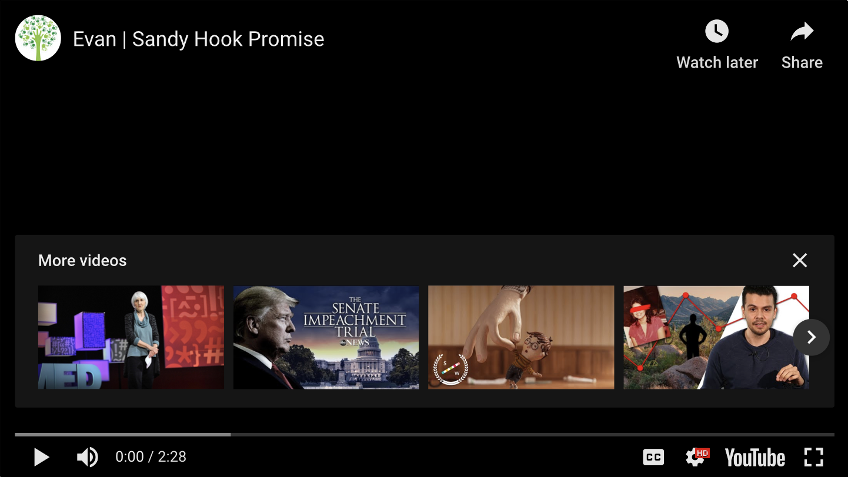
Can You See the Warning Signs ?

Slide 8


